Slide 1


+
Dr. Kent Blacklidge
Notes:
My 20 years in the newspaper business instilled within me a strong principle and that is the public has a right to know all about things that impact their lives. No exceptions. Nothing could be stronger than the right to know all about how the food they put into their bodies is grown, processed and presented.

Slide 2

Dr. Kent Blacklidge
Background
20 years in management at The Kokomo Tribune; 4 as Publisher
(a 34,000 daily newspaper)
Vice Chancellor/External Relations at Indiana University Kokomo
Taught biology, environmental science, and mathematics at the university level
Purdue University:
B.S. Industrial Management, Krannert School of Management
M.S. in Conservation of Natural Resources, FNR
M.S. in Aquatic Toxicology and Fish Biology, FNR
Ph.D. in Genetics, AS
Associate Fisheries Scientist/American Fisheries Society
Notes:
Dr. Kent Blacklidge:
20 years in management at The Kokomo Tribune; 4 as Publisher
Vice Chancellor of External Relations at Indiana University Kokomo
Taught biology, environmental science and mathematics at the university level
From Purdue University:
B.S. and post graduate studies in Industrial Management
M.S. in Conservation of Natural Resources
M.S. in Aquatic Toxicology and Fish Biology
Ph.D. in Genetics
Associate Fisheries Scientist/American Fisheries Society

Slide 3
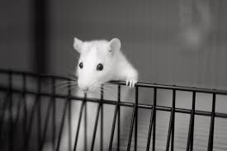
UP FRONT
Public “Right to Know” is Absolute…
Biotechnology may or may not be safe as currently applied in agriculture, BUT People are not “lab rats” to be experimented upon without informed consent………………
Notes:
My 20 years in the newspaper business instilled within me a strong principle and that is the public has a right to know all about things that impact their lives. No exceptions. Nothing could be stronger than the right to know all about how the food they put into their bodies is grown, processed and presented.

Slide 4
20th Century
Small family farms
Diversified crops and livestock
Local production, processing, and markets
Chemicals came mid-Century around WWII
1953 – Watson/Crick and DNA structure
1962 – Silent Spring; DDT banned 1972
1971 – Earl Butz, Sec. of Agriculture
1970s-80s – gene technology developed
1992 – Bush/Quayle Council on Competitiveness
1994 – FlavrSavr Tomato in markets
Notes:
For the first half of the 20th Century, we saw many smaller family farms that grew several crops including truck garden produce which they sold to local markets. When they raised corn and beans, they did so using crop rotation methods with every third year a field being fallow or pasture for livestock. During WWII, about everyone had a Victory Garden of vegetables.
It was common to see small neighborhood meat markets and groceries. My wife’s family owned just such a market from the early 1900s until about 1960 in Bay City, Michigan. I remember others in our immediate area that had a meat counter and an area of canned goods, produce, and dairy products. There were no super stores. We had local dairies: Med O Bloom and Crescent Dairy. Milk was produced locally. Meats were butchered locally. Vegetables and meats were produced locally and eaten locally.
Farm chemicals became wide spread in mid-century. DDT was famous. It was sprayed everywhere. I remember in my neighborhood, we waited for the fogging truck on our bicycles. We rode in the cloud…. It smelled sweet. Rachael Carson changed that in 1962, thankfully.
The notion of industrial farming began sometime mid-century or a little later. Earl Butz, a Dean of the School of Agriculture at Purdue who became Secretary of Agriculture in 1971 under President Nixon, is famous for his advice to farmers….”get big or get out”. His big push was for corn. His directed policy shifts coincided with the rise of major agribusiness corporations and the declining financial stability of small family farms. He encouraged this.
Time and science went on. Techniques for moving genes from one species to another were developed during the 1970s and 1980s. Humulin or human insulin from E Coli bacteria that had been genetically altered became available in 1978. About 14 years later in 1992, the world changed. Genetically engineered field crops were about to enter our world. In 1994, the Flavr Savr Tomato was on grocery shelves. It had been genetically modified for longer shelf life or slower rotting. It was the first.

Slide 5
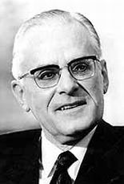
Secretary Earl Butz
Farming became industrialized under Secretary of Agriculture (1971-76) Earl Butz in the 1970s. A Hoosier (and former Purdue School of Agriculture Dean), told farmers to “get big or get out,”. He advised farmers to “plant single crops from fence to fence & mass produce animals like cows and chickens as if they were Fords and Chevys”.
This government policy led to the demise of the family farm and the take-over by large agribusiness corporations. It continues today.
Most of the processed food in groceries today is controlled by only ten giant corporations.

Slide 6

Face the Mortality Gap
The doctor’s news is not good. Americans are in poorer health and are dying sooner than the rest of the industrialized world. ……A 2011 study of 17 industrialized countries – 13 in Western Europe, plus the U.S., Australia, Japan and Canada – found that American men, whose life expectancy is 75.6 years, ranked last, and U.S. women, at 80.7 years, ranked 16th. Worse, this gap has been widening for the past three decades. Wonder why this is happening? So did the National Institutes of Health, which ordered a broad study of U.S. deaths …….
Bulletin
March 2013
Notes:
From the March 2013 AARP Bulletin: USA health.
Study over a period of 30 years back to about 1980 or so.
American male life expectancy is last among 17 industrialized nations
American female life expectancy is 16th of 17.
Gap continues widen.
Correlation with introduction of GM crops????

Slide 7
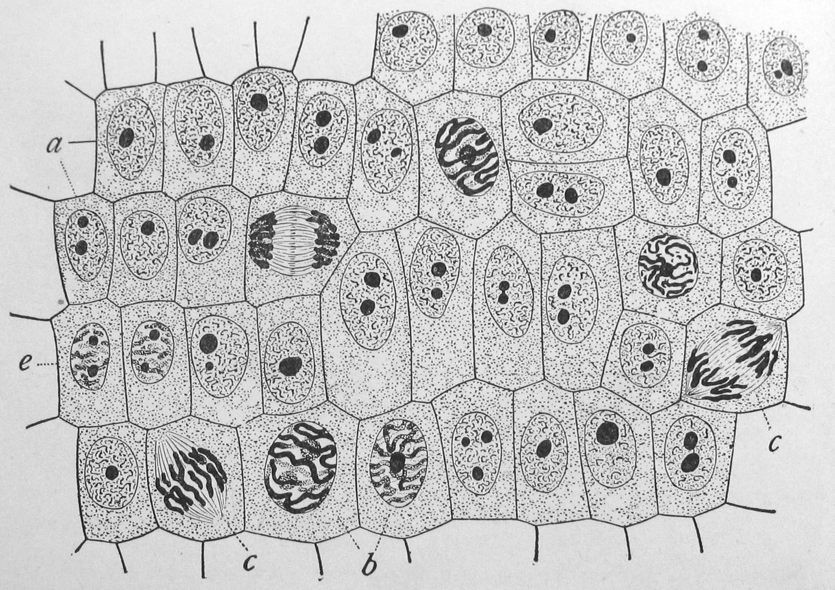
Who Are You?
We tend to think that we are exclusively a product of our own cells, upwards of ten trillion of them. But the microbes we harbor (living in or on us) add another 100 trillion cells into the mix. The creature we admire in the mirror every morning is thus about 10% human by cell count.....
Notes:
We are not who we think we are when walking around. Only about 10% of what we see in our body are human cells, the other 90% are all sorts of microbes that live in and on us; most are beneficial to our lives.

Slide 8

And….
… while our 21,000 or so human genes help make us who we are, our resident microbes possess another 8,000,000 or so genes, many of which collaborate behind the scenes handling food, tinkering with the immune system, turning human genes on and off, and otherwise keeping us functioning.
Smithsonian May 2013
Notes:
It is our job to keep everything happy. This means treating our bodies well and taking in healthy foods.

Slide 9

Genetically Modified Foods
Genetically Engineered Foods
Genetically Modified Organisms/GMOs
Notes:
This presentation is based in part on information contained in the book Genetic Roulette: The Documented Health Risks of Genetically Engineered Foods and Seeds of Deception, both by Jeffrey Smith. Full citations for the studies presented are found in Genetic Roulette.
Two Primary issues: Human health and Environmental health

Slide 10
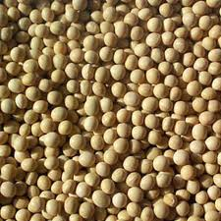
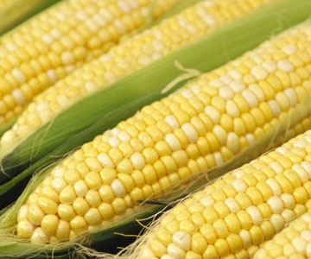
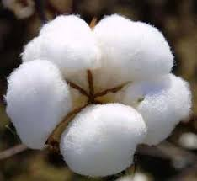

US GM crops
Soy 94%
Corn 89%
Cotton 93%
Canola 90% (Canada)
Sugar beets 95%
Alfalfa (hay, not sprouts) ?%
Notes:
10
What is genetically engineered in the US?
Right now soy, corn, cotton, canola, and sugar from sugar beets are the main sources. Soy and Corn derivatives are in most processed foods. If it comes in a box from the supermarket, it is probably genetically engineered. The first four are used in vegetable oil. The US sugar beet growers introduced GM sugar at the end of 2009. Unless an ingredient says pure cane sugar, it is a mixture of cane and sugar beet. GM alfalfa is used as hay for animals.

Slide 11
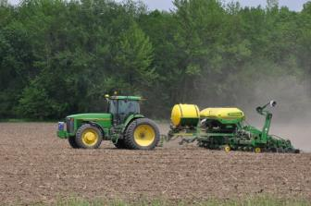
Suppliers of GM Seeds
Proprietary (Patented) seed market is about 82% of the commercial seed market worldwide
Monsanto – 23% of PSM
Pioneer/DuPont – 15% of PSM
Syngenta – 9% of PSM
Bayer Crop Science – 2%
Monsanto controls 72% of the
US corn crop
Notes:
Proprietary seeds are seeds that have been have become “intellectual property” through patent, for example. The use of these seeds is controlled by corporations, not farmers. Monsanto is the corporation that controls the largest share. The four above control almost 50% of the proprietary seed market and a little over 40% of the total world wide seed market; proprietary and non-proprietary. Monsanto now controls about 72% of the corn crop in the United States.

Slide 12
cells
nucleus
chromosome
DNA
gene
A
A
C
T
C
G
T
Basepairs: A-T & C-G (nucleotides)
T
T
G
A
G
C
A
Notes:
To understand what Genetically Modified Organisms or GMOs are, let’s first review what DNA is (dioxyribonucleaic acid). Within the tissues of the plant are cells. Within the cell is the nucleus. Within the nucleus are chromosomes composed of the DNA molecule, which in turn is made up of a sequence of base pairs. There are only four compounds: adenine which always pairs with thymine and cytosine which always pairs with guanine. A simplistic description is that a sequence of the base pairs makes up the genes in the DNA that determine the sequence in the RNA, which determines the sequence of the amino acids which are the building blocks of proteins. These proteins determine a particular trait or characteristic or function.
So…. DNA to RNA to Protein
Protein function depends upon amino acid sequence, associated molecules, and 3 dimension or folded structure.

Slide 13
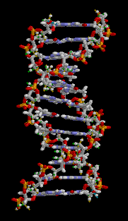
6 billion rungs
on the DNA ladder in human genome
DNA Double Helix
If one foot apart as in a home step ladder….. the ladder would stretch over 1.1 million miles or around the Earth over 45 times!
Deoxyribonucleic acid
Notes:
Here is a representation of the DNA double helix. There are about 6 billion pairings in the Human genome located on 46 Chromosomes; 23 from each parent. Haploid number would be 3 billion base pairs

Slide 14
The Codes
Alphabet – 26 characters
ABCDEFGHIJK…..WXYZ
Computer – 2 numbers
0110111001010111010…
Genetic – 4 nucleotides (or molecules)
ATCCAATGTACGGATTCC…
(Adenine/Thymine, Cytosine/Guanine)
Notes:
AT Adenine and Thymine
CG Cytosine and Guanine

Slide 15
How does
Genetic Engineering work?
Isolate a gene that codes for a desired trait/characteristic
Change the gene so it will work in plants/animals
(add promoter, remove introns, and more)
Prepare recipient cells or eggs
Transform cells using a gene gun , microinjection, electroporation, or bacteria/virus infection
Grow cells to plants via tissue culture or incubate animal cells to maturity
Notes:
Using genetic engineering, scientists take genes from bacteria, viruses or other sources and insert them into the DNA of a plant or animal. There are 5 steps. (1) First they isolate the gene that they want to insert and then (2) change it so that it works in plants or animals. They prepare recipient cells or tissue or eggs. Insertion is often done using a gene gun in plants, where they coat tiny particles of gold or tungsten with genes and then shoot them into a plate of cells. Alternatively, they can use bacteria or viruses to infect plants with the foreign gene. In animal cells, microinjection may be used. Once the gene gets into the DNA of the plant cell, the cell is cloned (using tissue culture) into a full plant. Animal cells are incubated to maturity. All but one of these steps contain scientific uncertainties and risks for health and the environment.

Slide 16
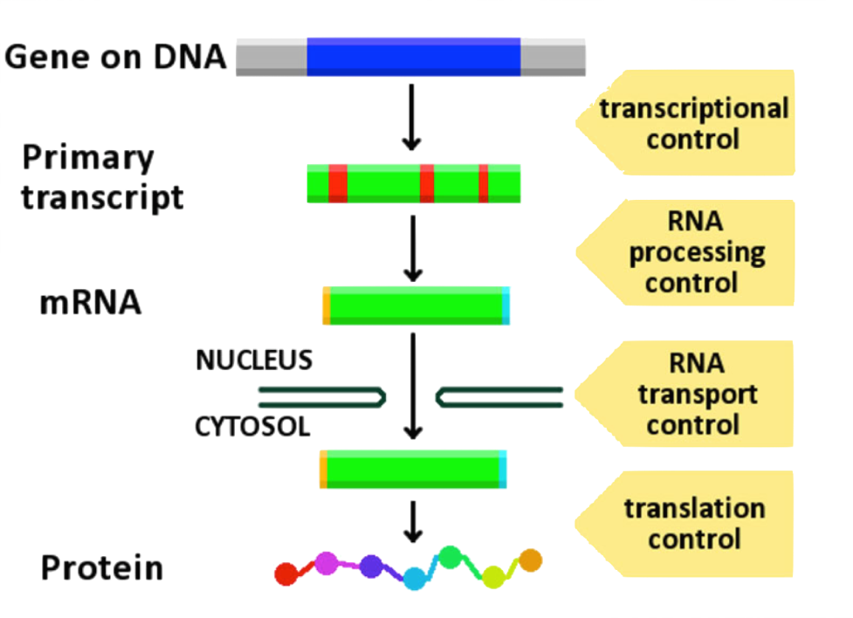
Notes:
Several steps between the information on DNA and the creation of a protein from the assembly of amino acids. The protein is created from the DNA code, the amino acids are assembled in line, and the final protein structure is 3 dimensional. Must be folded a certain way to function properly.

Slide 17

Gene Construct
Promoter: On switch
often CaMV (virus)
e.g. Bt toxin gene from soil bacterium
Gene sequence
e.g. from pea
“Stop” signal
FOR PLANTS, CONSTRUCT INCLUDES ANTIBIOTIC RESISTANT GENE!!!
Notes:
17
Here is a diagram representing the gene that is inserted. It is called a transgene or gene construct. (Or if multiple genes are involved, it is called a “gene cassette”.) Let’ say scientists want to create a corn plant that produces its own pesticide. They typically take a gene from bacteria that produces its own pesticide. The most common bacteria used are called Bt for Bacillus Thuringiensis and the pesticidal toxin it creates is called Bt-toxin. If you take the pesticide-producing Bt gene from the bacterium and put that inside corn by itself, it wouldn’t work. Plant DNA is normally designed to turn genes on and off as needed by the cell. But there is no corn on earth that has ever had this BT gene before the advent of genetic engineering. The corn plant does not know how to turn it on. So scientists attach a promoter, usually taken from a virus, which acts as an “on” switch. It turns the gene on 24/7. This BT gene is not under the control of the host DNA. It is under the control of this inserted viral promoter. On the other side of the gene, scientists attach a stop signal or termination signal, which tells the cell, “The gene ends here. Stop reading.”
Scientists make millions of copies of the transgene, which are either shot into millions of cells or infected into the cell by bacteria. The hope is that some of the genes make it into the DNA of some of those cells. They can’t tell which of the genes make it into the DNA. So, they do the following: Before they multiply and insert the gene construct, they add an antibiotic resistant marker gene. This new gene creates a protein that protects the cell from a specific antibiotic. So, in this specific case, they transfer two genes, one that will cause production of Bt pesticide protein and the other that will cause production of a protein that gives an antibiotic resistance character to a cell.

Slide 18
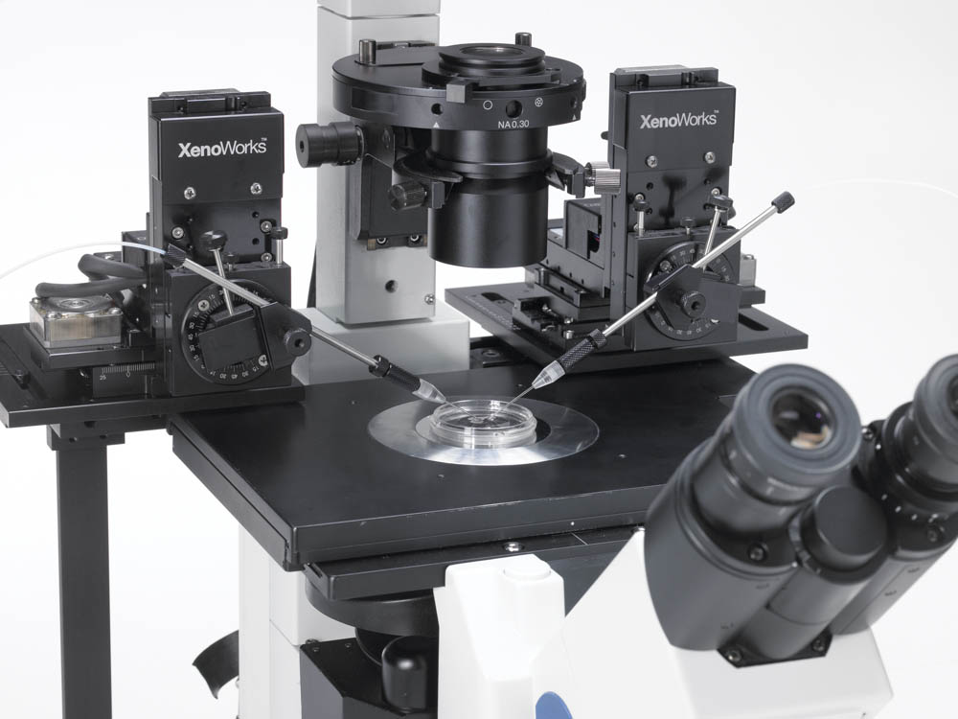
Microinjection Station

Slide 19
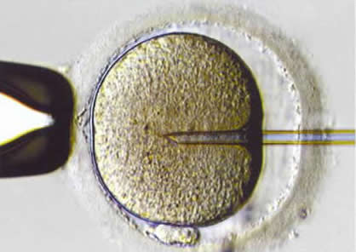
Microinjection in Eggs
Notes:
Use of microinjection on an egg. The image on left is the “holding pipette”; on the right is the glass needle injecting genes. Other methods include the following:
Gene gun
Bacterial and Viral Vectors
Electroporation

Slide 20
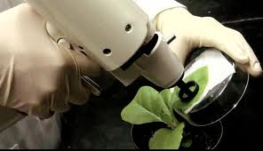
Gene Gun with Plant Cells
Notes:
Use of a gene gun to transfer genes into cells in a plant leaf. Other means of transfer of genes include the following:
Microinjection for animal eggs
Bacterial and Viral Vectors
Electroporation

Slide 21
Identify plant cells with incorporated genes
Test for markers
Add antibiotic
Only transformed
cells survive
Notes:
Next, they dowse that plate of cells with antibiotics. It kills off most of the cells except the very few where the transgene made it into the DNA—where the antibiotic resistant gene is functioning. Thus, the surviving cells are antibiotic resistant.

Slide 22
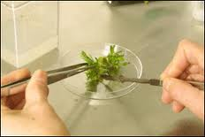
Grow transformed GM cells
via cloning (tissue culture)
Notes:
The surviving cells are cloned into GM plants. Each cell of each plant now contains the gene that produces the Bt-toxin. It also contains the antibiotic resistant gene, which is now in our food

Slide 23

Antibiotic Resistant Genes
“IT WOULD BE A SERIOUS HEALTH HAZARD TO INTRODUCE A GENE THAT CODES FOR ANTIBIOTIC RESISTANCE INTO THE NORMAL FLORA OF THE GENERAL POPULATION.”
Director, Division of Anti-infective Drug Products
Notes:
. FDA scientists who evaluated the use of the antibiotic resistant gene were appalled with the idea.
Documents made public from a lawsuit revealed that the FDA division of anti-infective drugs wrote in all capital letters, “IT WOULD BE A SERIOUS HEALTH HAZARD TO INTRODUCE A GENE THAT CODES FOR ANTIBIOTIC RESISTANCE INTO THE NORMAL FLORA OF THE GENERAL POPULATION.” They were concerned that the antibiotic resistant marker gene might transfer to disease-creating bacteria in the gut or in soil, rendering the bacteria invincible to antibiotics. There are already antibiotic resistant super-diseases due to the overuse of antibiotics, but the FDA scientists were concerned that this use in GM foods could make the problem much worse.
This was not the only concern among the FDA scientists.
[For source documents with FDA quotes, go to www.ResponsibleTechnology.org.)

Slide 24




Allergens
Toxins
New diseases
Nutritional problems
Agency scientists
warned of:
Notes:
24
The overwhelming consensus among the agency’s own scientists was that GM foods could lead to unexpected, hard to detect side effects, including allergens, toxins, new diseases, and nutritional problems. The scientists urged their superiors to require long-term safety studies.

Slide 25

What was said within FDA
“The processes of genetic engineering and traditional breeding are different, and according to the technical experts in the agency, they lead to different risks.”
Linda Kahl, FDA compliance officer
Notes:
An FDA compliance officer, summarizing all the memos from the various individuals and divisions at the agency, wrote: “The processes of genetic engineering and traditional breeding are different, and according to the technical experts in the agency, they lead to different risks.”

Slide 26

By “trying to force an ultimate conclusion that there is no difference between foods modified by genetic engineering and foods modified by traditional breeding practices,” the agency was “trying to fit a square peg into a round hole.”
Linda Kahl, FDA compliance officer
Notes:
She continued: By “trying to force an ultimate conclusion that there is no difference between foods modified by genetic engineering and foods modified by traditional breeding practices,” the agency was “trying to fit a square peg into a round hole.”

Slide 27
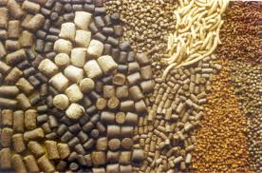
“Animal feeds derived from genetically modified plants present unique animal and food safety concerns.”
Gerald Guest, Director, FDA’s
Center for Veterinary Medicine (CVM)
Notes:
One division director not only said there were “unique animal and food safety concerns” from GM plants, but, in an apparent protest against the proposed wording of the FDA policy, he said, “I would urge you to eliminate statements that suggest that the lack of information can be used as evidence for no regulatory concern.” He was ignored.

Slide 28

“There is a profound difference between the types of unexpected effects from traditional breeding and genetic engineering,”
“There is no certainty that [breeders] will be able to pick up effects that might not be obvious.”
“This is the industry’s pet idea, namely that there are no unintended effects that will raise the FDA’s level of concern. But time and time again, there is no data to back up their contention.”
FDA microbiologist Louis Pribyl
Notes:
FDA microbiologist Louis Pribyl wrote: “There is a profound difference between the types of unexpected effects from traditional breeding and genetic engineering,”
“There is no certainty that [breeders] will be able to pick up effects that might not be obvious.”
“This is the industry’s pet idea, namely that there are no unintended effects that will raise the FDA’s level of concern. But time and time again, there is no data to back up their contention.”
In spite of the scientists’ memos, each subsequent draft of the FDA policy removed more and more of their concerns.

Slide 29
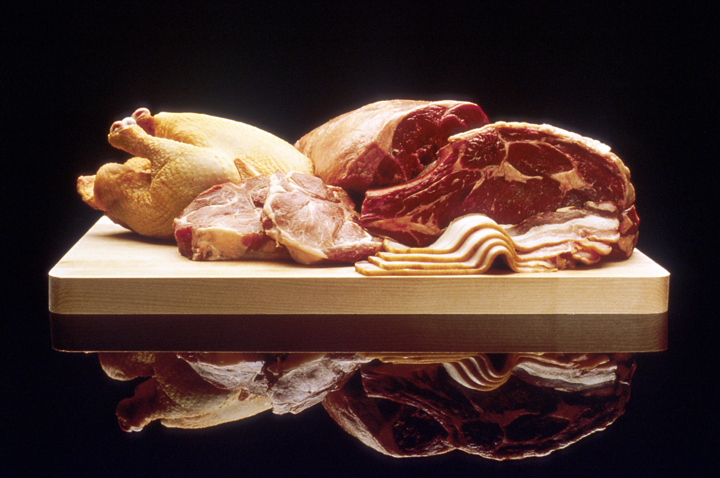
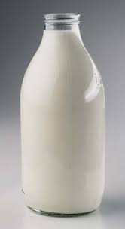
“Residues of plant constituents or toxicants in meat and milk products may pose human food safety concerns.”
Gerald Guest, Director, FDA’s
Center for Veterinary Medicine (CVM)
Notes:
The Center for Veterinary Medicine (CVM) was worried that meat and milk from animals fed GM feed might be toxic.
Other experts and departments described concerns for allergens, which may be impossible to identify before a GM food is released into the market.
With all these concerns, here is what the official policy of the FDA states.

Slide 30

FDA declares GMOs no different
“The agency is not aware of any information showing that foods derived by these new methods differ from other foods in any meaningful or uniform way.”
“Statement of Policy”
May 29, 1992
Food and Drug Administration
Notes:
30
In spite of scientists’ concerns, the FDA policy stated in May 1992 which guides decisions even today said…
“The agency is not aware of any information showing that foods derived by these new methods differ from other foods in any meaningful or uniform way.” This sentence in the 1992 FDA policy, which still stands today, is the reason why GM crops are on the market. On the basis of this statement, the FDA said no safety testing was necessary. If Monsanto or the other biotech food companies say their foods are safe, the FDA has no further questions.
Our own Vice President Dan Quayle was the Chairman of the committee that promoted biotechnology as well. George H.W. Bush was President. The mantra at the time was to deregulate generally and to promote biotechnology specifically around the world.

Slide 31


“What has happened to the scientific elements of this document? Without a sound scientific base to rest on, this becomes a broad, general, ‘What do I have to do to avoid trouble’-type document. . . . It will look like and probably be just a political document. . . . It reads very pro-industry, especially in the area of unintended effects.”
FDA microbiologist Louis Pribyl
Notes:
When reviewing the changes made in the GMO policy drafts, Pribyl wrote:
“What has happened to the scientific elements of this document? Without a sound scientific base to rest on, this becomes a broad, general, ‘What do I have to do to avoid trouble’-type document. . . . It will look like and probably be just a political document. . . . It reads very pro-industry, especially in the area of unintended effects.”

Slide 32

Who overruled
the scientists?
Michael Taylor
In charge of FDA policy
Former Monsanto attorney
Later Monsanto vice president
Now President Obama’s US Food Safety Czar
Actions supported by President George H.W. Bush and Vice President Dan Quayle via the Council on Competitiveness 1992
Notes:
32
Who overruled the scientists? The man in charge of FDA policy, Michael Taylor. He was Monsanto’s former attorney, and later their vice-president. The White House under George H. W. Bush had instructed the FDA to promote the biotechnology industry, and so the FDA created a new position for Michael Taylor. As a result of the policy that he oversaw, if Monsanto and others want to put a GM crop on the market, they don’t even have to tell the FDA. GM companies do participate in a voluntary and highly superficial consultation process with the FDA, in which they offer just summary data and their own conclusions of safety.
The Obama administration has re-installed Taylor at the FDA, as the US Food Safety Czar.

Slide 33


‘Based on the safety and nutritional assessment you have conducted, it is our understanding that Monsanto has concluded that corn products derived from this new variety are not materially different in composition, safety, and other relevant parameters from corn currently on the market, and that the genetically modified corn does not raise issues that would require premarket review or approval by FDA. . . . as you are aware, it is Monsanto’s responsibility to ensure that foods marketed by the firm are safe...’“
FDA Letter to Monsanto, 1996
Notes:
33
Who overruled the scientists? The man in charge of FDA policy, Michael Taylor. He was Monsanto’s former attorney, and later their vice-president. The White House under George H. W. Bush had instructed the FDA to promote the biotechnology industry, and so the FDA created a new position for Michael Taylor. As a result of the policy that he oversaw, if Monsanto and others want to put a GM crop on the market, they don’t even have to tell the FDA. GM companies do participate in a voluntary and highly superficial consultation process with the FDA, in which they offer just summary data and their own conclusions of safety.
The Obama administration has re-installed Taylor at the FDA, as the US Food Safety Czar.

Slide 34
Food Safety?
“Monsanto should not have to vouchsafe the safety of biotech food. Our interest is in selling as much of it as possible. Assuring its safety is the FDA’s job.” – Philip Angell, Monsanto Director of Communications
“Ultimately, it is the food producer who is responsible for assuring safety.” – US FDA
“It is not foreseen that EFSA carry out such (safety) studies as the onus is on the (GM industry) applicant to demonstrate the safety of the GM product in question.” – European Food Safety Authority (EFSA)

Slide 35
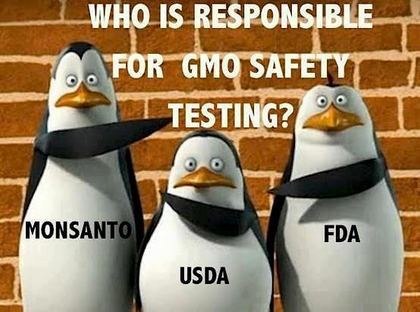

Slide 36

Problems
A look at 5 possible…
Notes:
We will look at five possible causes for problems related to GM foods.

Slide 37
First possible cause of problems
The process of creating a GM crop creates unpredicted changes in DNA and recipient plant composition
Notes:
The first is that process of creating a GM crop may create unpredicted changes in DNA and plant composition.

Slide 38

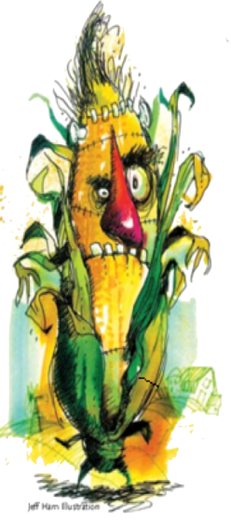
Unexpected
changes
in the DNA
Mutations (2-4% of DNA)
Deletion of genes
Permanently on or off
Altered gene expression: up or down regulation up to (up to 5%)
DNA changes can alter RNA and ultimately the resulting proteins.
Notes:
The process of inserting a transgene causes mutations, or changes in the sequence of the genetic code, near the insertion site and elsewhere. Inserting the transgene can delete natural native genes. In one study, 13 genes were deleted by a single insertion. Sometimes, the transgene will be imbedded in the middle of a native gene, changing its function.
Native genes can be switched off permanently, or even turned on permanently. The biotech industry claimed the promoter they insert would only turn on the transgene. That is not true. The promoter can actually turn on other genes downstream from the transgene--permanently. This many cause it to overproduce its protein in high volume, which might be an allergen, toxin, carcinogen, or anti-nutrient.
The process of cloning a cell into a plant can create hundreds or thousands of additional mutations up and down the DNA. According to two studies, the GM DNA is 2-4% different than the DNA of its parent. Most of the changes are unpredicted mutations.
In addition, inserting a single gene can change how much protein is being produced in hundreds or thousands of genes. Scientists tested the process of inserting a single gene into a human cell and found that up to 5 percent of the genes changed their levels of expression.
Taken together, genetic engineering causes massive collateral damage in the DNA.
Biotech industry scientists and regulators, on the other hand, operate as if genes were like Legos that cleanly snap in place, and operate independently of the other genes in the DNA.
[Allison Wilson, PhD, Jonathan Latham, PhD, and Ricarda Steinbrecher, PhD, “Genome Scrambling—Myth or Reality? Transformation-Induced Mutations in Transgenic Crop Plants Technical Report—October 2004, http://www.econexus.info; see also J. R. Latham, et al., “The Mutational Consequences of Plant Transformation,” The Journal of Biomedicine and Biotechnology 2006, Article ID 25376: 1–7.]

Slide 39

Disruption of gene networks
July 1, 2007, New York Times:
The presumption that genes operate independently has been institutionalized. . . . It is the economic and regulatory foundation on which the entire biotechnology industry is built.
Evidence of a networked genome shatters the scientific basis for virtually every official risk assessment of today’s commercial biotech products.
Yet to date, every attempt to challenge safety claims for biotech products has been categorically dismissed, or derided as unscientific.
Notes:
On July 1, 2007, the New York Times wrote:
The presumption that genes operate independently has been institutionalized. . . . It is the economic and regulatory foundation on which the entire biotechnology industry is built.
Evidence of a networked genome shatters the scientific basis for virtually every official risk assessment of today’s commercial biotech products.
Yet to date, every attempt to challenge safety claims for biotech products has been categorically dismissed, or derided as unscientific.

Slide 40
DNA changes can alter:
RNA
Proteins
Natural Compounds
Notes:
40
DNA creates RNA, and the RNA creates proteins. Proteins interact and create all the hundreds or thousands of natural products that make plants unique. Each element in this process might be altered as a result of the unpredicted changes in the DNA.

Slide 41

United Kingdom initiated
long-term safety studies
Notes:
41
An example of unpredicted side-effects due to the process of genetic engineering was accidentally discovered in a UK government-funded study. The government was seeking to create the ideal safety testing protocol for GM crops, which was to be eventually implemented into the EU approval process. Twenty-eight scientists applied for the $3 million grant, which was ultimately awarded to

Slide 42
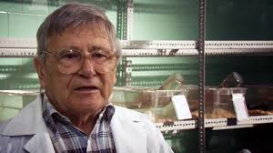
Fellow of the Royal Society of Edinburgh
Three books and over 270 scientific papers
Competed with 28 other research groups
Awarded the multi-million dollar, three year, multi-center research grant
Methodology approved by the Biotechnology and Biological Sciences Research Council (BBSRC)
Dr. Arpad Pusztai
Rowett Research Institute, Scotland
Notes:
This man, Dr. Arpad Pusztai, the world’s leading expert in his field, working at a top nutritional research institute in the UK, the Rowett Research Institute in Aberdeen, Scotland conducted research with GMOs.
Part of their research included creating a GM potato that produced its own insecticide. They fed the GM potato to the rats. They also fed another group of rats a potato spiked with the same pesticide that the GM potato was engineered to produce, and the third group got regular potatoes. They even varied it so that different rats ate baked, raw, or boiled potatoes. And all groups received a balanced diet. The group that ate the GM potatoes was seriously damaged. The potato spiked with the insecticides did not show problems. What then was the cause for the health damage? It was not the insecticide. It is most likely the process of genetic engineering.

Slide 43
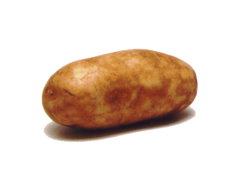
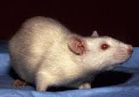
Rats fed GM potato
(had been modified to produce a pesticide)
  Lining of the small intestine showed elevated white cell counts
Thymus and spleen showed negative changes
White blood cells responded more slowly
(Ewen and Pusztai )
Notes:
Research results with the GMO potato when fed to rats.

Slide 44

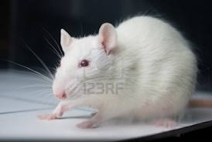
GM potatoes damaged rats
(10 or 110 days)
Rats developed
Potentially pre-cancerous cell growth in the digestive tract
Smaller brains, livers and testicles
Partial atrophy of the liver
Immune system damage
Lancet, 1999 & others
Notes:
The rats developed potentially precancerous cell growth in the digestive tract, smaller brains, livers and testicles, partial atrophy of the liver and damaged immune systems.
[Arpad Pusztai, “Can science give us the tools for recognizing possible health risks of GM food,” Nutrition and Health, 2002, Vol 16 Pp 73-84; and Stanley W. B. Ewen and Arpad Pusztai, “Effect of diets containing genetically modified potatoes expressing Galanthus nivalis lectin on rat small intestine,” Lancet, 1999 Oct 16; 354 (9187): 1353-4.]

Slide 45
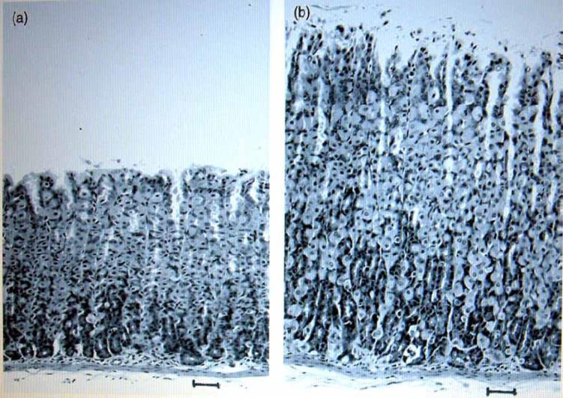
Stomach lining
Non-GM
GM
Notes:
The picture on the left is the stomach wall of a rat who was fed non-GMO potato. On the right is the stomach wall of a rat who was fed the GM-potato.
With permission from his institute director, Dr. Arpad Pusztai was interviewed on national TV and expressed concerns about GM food safety. He was a hero for about 2 days at his prestigious institute. Then, two phone calls were allegedly placed from the UK Prime Minister’s office, forwarded through the receptionist, to the director. The next day, Dr. Pusztai was fired from his job after 35 years and silenced with threats of a lawsuit. His 20 member research team was disbanded, and the data was kept hidden. The institute put out a number of statements designed to damage the reputation of Dr. Pusztai and to support GMOs. The safety testing protocols his team was working on were never implemented.
Eventually he was invited to speak before parliament about his work, which lifted the gag order and allowed him to access his data. The study was eventually published in The Lancet. It is arguably the most in-depth animal feeding study ever published on GM foods. It shows that the process itself might be inherently dangerous. It is noteworthy that the same process used to create Dr. Pusztai’s potatoes were used to create the GM crops on the market. But we don’t know if those products cause the same damage in our guts as they do in rats, since no studies have been conducted on the commercialized GM foods that adequately tests for the problems that Dr. Pusztai found.

Slide 46

What Happened to Dr. Pusztai?
With permission from the Director, Pusztai was interviewed on TV where he expressed concerns over the safety of GMO’s
Two days later he was fired.
He was silenced by threat of a law suit and data was seized.
His 20 member research group was disbanded.
The safety protocol they developed was never implemented.
Eventually, he was called to testify before Parliament where he was vindicated.
His research results were ultimately published in “The Lancet”, a well respected scientific journal.
Dr. Pusztai has since retired…..
He continues to speak out.
Notes:
The picture on the left is the stomach wall of a rat who was fed non-GMO potato. On the right is the stomach wall of a rat who was fed the GM-potato.
With permission from his institute director, Dr. Arpad Pusztai was interviewed on national TV and expressed concerns about GM food safety. He was a hero for about 2 days at his prestigious institute. Then, two phone calls were allegedly placed from the UK Prime Minister’s office, forwarded through the receptionist, to the director. The next day, Dr. Pusztai was fired from his job after 35 years and silenced with threats of a lawsuit. His 20 member research team was disbanded, and the data was kept hidden. The institute put out a number of statements designed to damage the reputation of Dr. Pusztai and to support GMOs. The safety testing protocols his team was working on were never implemented.
Eventually he was invited to speak before parliament about his work, which lifted the gag order and allowed him to access his data. The study was eventually published in The Lancet. It is arguably the most in-depth animal feeding study ever published on GM foods. It shows that the process itself might be inherently dangerous. It is noteworthy that the same process used to create Dr. Pusztai’s potatoes were used to create the GM crops on the market. But we don’t know if those products cause the same damage in our guts as they do in rats, since no studies have been conducted on the commercialized GM foods that adequately tests for the problems that Dr. Pusztai found.

Slide 47

A second cause of problems
The protein produced
by the inserted gene
may be harmful
Notes:
The second cause of problems is the intended protein, produced by the inserted gene, may be harmful.

Slide 48

Two
primary traits are desired in GM crops
Herbicide tolerance (73%)
  Roundup Ready
  Liberty Link
Pesticide production (18%)
  Bt toxin (Bt corn, cotton, etc)
Crops with both traits (8%)
Notes:
48
There are two primary traits engineered into GM soy, corn, cotton, and canola. They are herbicide tolerance and pesticide production. With herbicide tolerance, the GM crops are inserted with a gene that allows them to survive applications of a particular herbicide. This is a great marketing opportunity for the manufacturers who sell the seeds and the herbicide as a package deal. For example, Monsanto sells Roundup Ready crops, which are engineered to survive applications of the company’s Roundup herbicide. Buyers even sign a contract with Monsanto saying they will only use Monsanto’s brand of herbicide with their GM crop.
The other major trait is pesticide production—in which every cell of the plant produces an insect-killing toxin.

Slide 49

Bt-toxin
Industry claims Bt:
Has a history of safe use
Is destroyed during digestion
Is not active in mammals
Notes:
49
Let us take a look at the Bt pesticide. As mentioned, there is a gene from soil bacteria that creates a poison, which kills specific insects. In its natural form, it is used in organic and conventional agriculture and forestry. Scientists take the bacterial gene, make changes so it will work in plants, and the put it into plant DNA. Now every cell of the plant creates the toxin. The reason why it is allowed in our food is because of the assumption that it has a history of safe use. They further assume that the protein is destroyed during digestion and that it wouldn’t interact with mammals or humans in any case. Mammals and humans do not even have receptor cells so they claim it would just pass right through the system if not digested.

Slide 50

In reality
People react to Bt spray
Bt gene survives digestion
Mice react to Bt-toxin
Notes:
50
It turns out that these assumptions are not true. In reality people do react to Bt spray. In fact, the label on the Bt spray bottle warns people not to consume it. Several studies show reactions among farmers, including antibody responses to Bt in the blood. More importantly, when they did an aerial BT spray for Gypsy Moth infestation in the Pacific Northwest, about 500 people reported allergic type reactions and some had to be hospitalized.
Bt toxin also survives digestion. When fed to mice, the lower part of their small intestines suffered tissue damage. There were fragments of cells, damaged cells, and potentially pre cancerous growth. Further, mice developed an immune response as if they had been fed Cholera toxin. They also develop an adjuvant response. This means they are sensitized to other compounds that they never reacted to before, as in the case of the condition called multiple chemical sensitivity.
[See for example: Washington State Department of Health, “Report of health surveillance activities: Asian gypsy moth control program,” (Olympia, WA: Washington State Dept. of Health, 1993); M. Green, et al., “Public health implications of the microbial pesticide Bacillus thuringiensis: An epidemiological study, Oregon, 1985-86,” Amer. J. Public Health 80, no. 7(1990): 848–852; M.A. Noble, P.D. Riben, and G. J. Cook, Microbiological and epidemiological surveillance program to monitor the health effects of Foray 48B BTK spray” (Vancouver, B.C.: Ministry of Forests, Province of British Columbia, Sep. 30, 1992); I.L. Bernstein et al, “Immune responses in farm workers after exposure to Bacillus thuringiensis pesticides,” Environmental Health Perspectives 107, no. 7(1999): 575–582; Nagui H. Fares, Adel K. El‐Sayed, “Fine Structural Changes in the Ileum of Mice Fed on En-dotoxin Treated Potatoes and Transgenic Potatoes,” Natural Toxins 6, no. 6 (1998): 219–233; Vazquez et al, “Intragastric and intraperitoneal administration of Cry1Ac protoxin from Bacillus thuringiensis induces systemic and mucosal antibody responses in mice,” 1897–1912; Vazquez et al, “Characterization of the mucosal and systemic immune response induced by Cry1Ac protein from Bacillus thuringiensis HD 73 in mice,” Brazilian Journal of Medical and Biological Research 33 (2000): 147–155; and Vazquez et al, “Bacillus thuringiensis Cry1Ac protoxin is a potent systemic and mucosal adjuvant,” Scandanavian Journal of Immunology 49 (1999): 578–584. See also Vazquez-Padron et al., 147 (2000b).]

Slide 51
Expert advisors to the EPA:
Mouse and farm worker studies:
“Suggest that Bt proteins could act as antigenic and allergenic sources.
… Only surveillance and clinical assessment of exposed individuals will confirm the allergenicity of Bt products.”
(EPA Scientific Advisory Panel 2001)
Notes:
The Environmental Protection Agency is in charge of the pesticide producing plants. But they only regulate the pesticide portion of the plant, which includes the Bt-toxin in corn and cotton plants. The EPA’s own Scientific Advisory Panel suggested that Bt-toxin may be allergenic. But the EPA has not changed their regulations or assumptions.

Slide 52
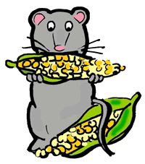
Mice That Ate Bt Corn
Multiple immune system responses – Government of Italy 2008
Increased infertility and lower birth weight – Government of Austria 2008
Indicators for liver and kidney toxicity, blood pressure problems, allergies, infections or disease, higher blood sugar and anemia – Monsanto study (released by lawsuit)
Notes:
In a study by Monsanto made public because of a lawsuit, rats fed Bt corn developed signs of liver and kidney toxicity. These included kidney inflammation and kidney lesions, and decreased kidney weight. The latter symptom is typically related to blood pressure problems. They also developed increased basophiles which are related to allergies. Increased lymphocytes or white blood cells which are part of the immune system indicating a reaction to infection or possibly disease. A 10% increase in blood sugar, and decreased immature red blood cells by 50%. This might indicate anemia. Two other rat studies by Monsanto also showed signs of toxicity as well. One was a Bt corn, and the other Roundup Ready.

Slide 53
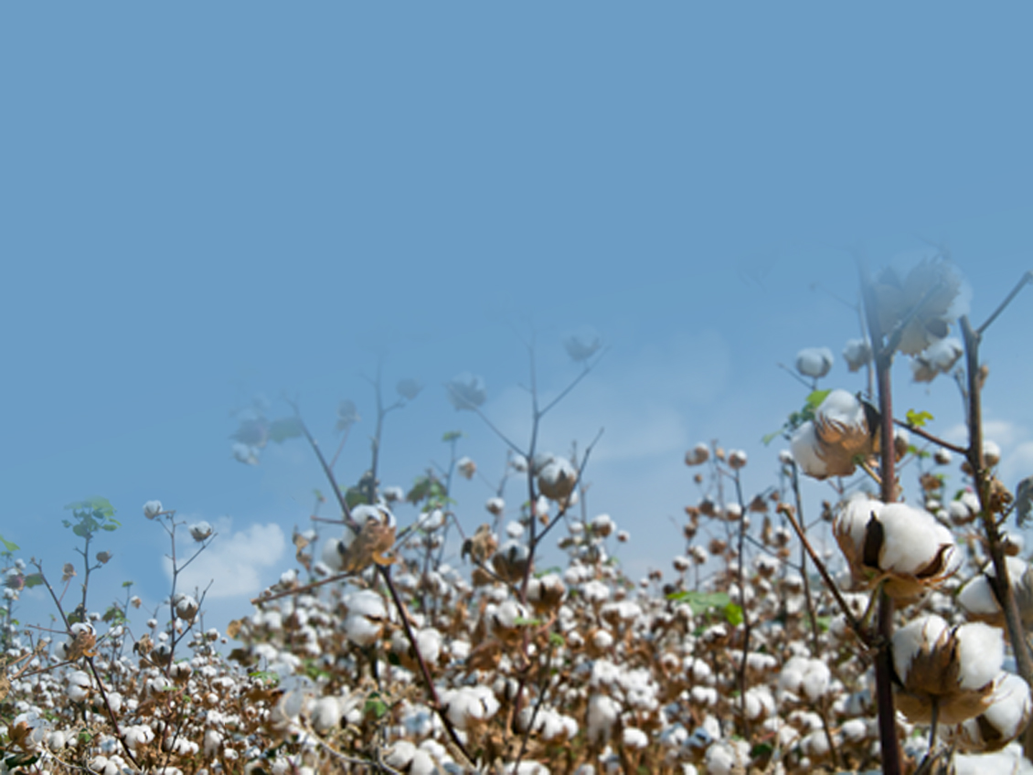
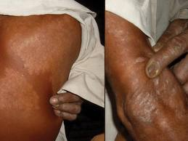
Bt cotton
Thousands of laborers in India reported allergic reactions to Bt cotton
Notes:
In India, hundreds of laborers picking cotton and working in cotton ginning factories developed allergic reactions when handling the BT cotton. This didn’t happen with the non-Bt varieties. There are many laborers who don’t go to work unless they’ve first taken an antihistamine.
[Ashish Gupta et. al., “Impact of Bt Cotton on Farmers’ Health (in Barwani and Dhar District of Madhya Pradesh),” Investigation Report, Oct–Dec 2005; plus numerous press reports]

Slide 54

The Sunday Indian
10/26/08
Hospital records: “Victims of itching have increased massively this year . . . related to BT cotton farming.”
Pharmacy manager: “Almost every cotton worker from this village suffers from itching.”
Notes:
Alternate slide
The Sunday Indian reported that according to Hospital records: “Victims of itching have increased massively this year . . . related to BT cotton farming.”
A Pharmacy manager said: “Almost every cotton worker from this village suffers from itching.”

Slide 55
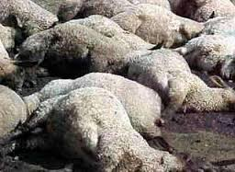
Bt cotton
Thousands of sheep died after grazing on Bt cotton plants
Notes:
After the Bt cotton is harvested, shepherds take their flocks into the area to graze on the Bt plants. Within 5 to 7 days, one out of four sheep died. Thousands died in total. Medical investigators found black patches in the intestine, liver, and bile ducts. The shepherds reported that there was nasal discharge, sense of dullness, depression, diarrhea, and coughing among the sheep. Animals continue to die in subsequent years after grazing in Bt cotton fields. Some regions also report allergic type itching reactions among livestock.
[“Mortality in Sheep Flocks after Grazing on Bt Cotton Fields—Warangal District, Andhra Pradesh” Report of the Preliminary Assessment, April 2006, http://www.gmwatch.org/archive2.asp?arcid=6494]

Slide 56
Post mortem …
Undigested food in rumen…….
Does Bt toxin kill rumen bacteria?
Notes:
56
There was also undigested food in the rumen (the first part of the animals digestive system). Sheep that grazed on Bt cotton plants also had shriveled intestines, suggesting that the plants never got past the rumen as well. Perhaps Bt toxin kills or interferes with the bacteria in the rumen that normally breaks down the plant matter.

Slide 57
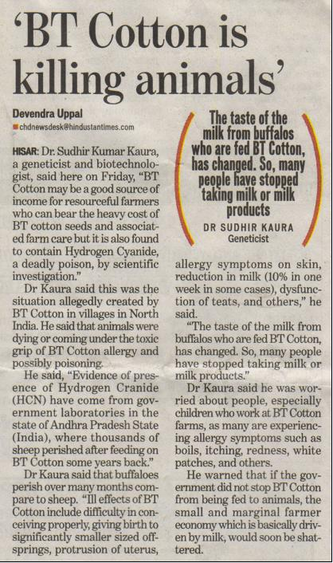
“The Indian government has advised farmers not to allow animals to graze on Bt cotton fields after four institutes reported the presence of toxins in them.”
The Hindustan Times, 17 June 2007
Notes:
The government of Andhra Pradesh in India is now warning farmers not to allow their animals to graze on Bt cotton fields.

Slide 58
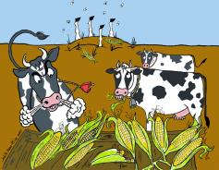
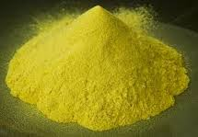
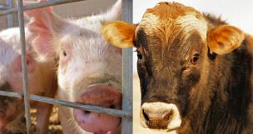
Other Reports
Cows in Germany died after eating Bt Corn
Farmers have reported pigs and cows becoming sterile or other reproductive problems
Inhaled pollen from Bt corn reportedly resulted in sneezing, asthma, coughs, nose bleeds, vomiting, stomach ache, dizziness, and weakness

Slide 59

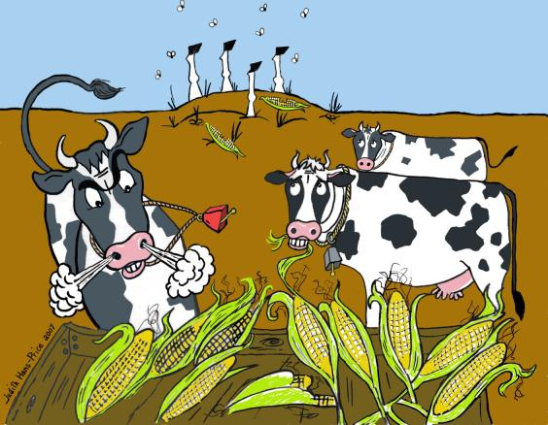
Bt corn, reports…
12 cows died on a
German
farm
Notes:
A German farmer says that a variety of Bt corn caused 12 of his cows to die, and others to fall sick. The corn producer, Syngenta, reimbursed the farmer for part of his losses but did not admit fault.
[Henning Strodthoff and Christoph Then, “Is GM maize responsible for deaths of cows in Hesse?,” Greenpeace Report, Greenpeace e.V. 22745 Hamburg. December 2003; and Mae-Wan Ho and Sam Burcher, “Cows Ate GM Maize & Died,” ISIS Press Release, January 13, 2004, http://www.isis.org.uk/CAGMMAD.php]

Slide 60

Bt corn, reports…
Farmers say pigs and cows became sterile
Notes:
About 25 farmers in the Midwest claim that their pigs and cows became sterile when they were feeding them certain varieties of BT corn. Some pigs developed false pregnancies and gave birth to bags of water. On one farm, the corn that apparently caused the pigs to become sterile was later fed to the cows, and they too became sterile. The reports of animal sterility were not followed up with tests by authorities, just denial that the problem was feed related.
[Numerous news reports and first hand accounts]

Slide 61
Bt corn, reports…
Inhaled pollen
may have
caused illness
Notes:
In the Philippines, villagers living adjacent to a Bt corn field developed serious health problems while the corn was pollinating. Over days, symptoms spread from those closest to the field to those further away.
[“Study Result Not Final, Proof Bt Corn Harmful to Farmers,” BusinessWorld, 02 Mar 2004; “Genetically Modified Crops and Illness Linked,” Manila Bulletin, 04 Mar 2004; Mae-Wan Ho, “GM Ban Long Overdue, Dozens Ill & Five Deaths in the Philippines,” ISIS Press Release, June 2, 2006; Allen V. Estabillo, “Farmer’s Group Urges Ban on Planting Bt Corn; Says It Could Be Cause of Illnesses,” Mindanews, October 19, 2004; and Jeffrey M. Smith, “Bt‐maize (corn) during pollination, may trigger disease in people living near the cornfield,” Press Release, February 2004, http://www.seedsofdeception.com/Public/AboutGeneticallyModifiedFoods/InhaledGMMaizePollenMayCauseDiseas/index.cfm]

Slide 62

Inhaled Bt Pollen
Sneezing, asthma
coughs, nose bleeds, swelling, fever, headache, stomach ache, dizziness, diarrhea, vomiting, weakness, and numbness
Notes:
Symptoms included skin reactions, intestinal reactions, and fever. A man who went into the field to investigate had a particularly serious reaction. He whole face swelled up, and he had trouble breathing.
The next year the same BT corn was planted in four other villages, and the mysterious disease reoccurred in each, only during the time of pollination.
[“Study Result Not Final, Proof Bt Corn Harmful to Farmers,” BusinessWorld, 02 Mar 2004; “Genetically Modified Crops and Illness Linked,” Manila Bulletin, 04 Mar 2004; Mae-Wan Ho, “GM Ban Long Overdue, Dozens Ill & Five Deaths in the Philippines,” ISIS Press Release, June 2, 2006; Allen V. Estabillo, “Farmer’s Group Urges Ban on Planting Bt Corn; Says It Could Be Cause of Illnesses,” Mindanews, October 19, 2004; and Jeffrey M. Smith, “Bt‐maize (corn) during pollination, may trigger disease in people living near the cornfield,” Press Release, February 2004, http://www.seedsofdeception.com/Public/AboutGeneticallyModifiedFoods/InhaledGMMaizePollenMayCauseDiseas/index.cfm]

Slide 63

Third reason for problems
The protein may be different than intended
Notes:
The third cause of problems may be that the protein created by the inserted gene may be different than intended.

Slide 64

The transgene sequence may:
Mutate or
truncate
Rearrange
Be read
differently
Produce
multiple
proteins
Notes:
The specific sequence of the inserted gene dictates the sequence of the amino acids of the protein it produces. If the sequence changes, so can the protein.
The inserted gene can mutate or truncate during the insertion process. One popular corn variety called Mon 810, for example, had 30% of the gene truncated during insertion, and produced a protein that was different than intended. Another corn variety Mon 863, had a mutated section.
The transgenes may also be unstable and rearrange over time, long after the crops have gone to market. Labs in France and Belgium analyzed the transgene sequence in 6 GM crops and found that in every case the sequence was different than that which was registered by the biotech company. In some cases, the sequence of the identical crop variety was different BETWEEN two labs, suggesting that the transgenes are not only unstable, but that they rearrange in a variety of ways. This means that they can be creating a range of untested, unintended proteins in our food supply.
Even if the transgene gets properly inserted and is stable, the DNA can be read differently than what was intended, producing different or multiple proteins. It might also produce harmful RNA.

Slide 65


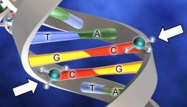
The protein may:
Be folded differently
(i.e. Mad Cow)
Have amino acid sequence altered
(i.e. Sickle Cell Anemia)
Have different molecules attached or attached in a different way
Notes:
Suppose that the transgene sequence turns out to be identical to what you wanted, that it remains stable and that it produces the amino acid sequence of the protein that you intended. You still might have a problem. Proteins get folded, and the folding might be different in the new organism. A protein's shape can determines its effect and a misfolded protein, or an aggregate of several misfolded proteins together, can be quite harmful. Prions are one form of a misfolded protein that is responsible for mad cow disease and the human variant, while amyloid fibrils are an example of aggregate proteins linked to a variety of medical conditions such as Alzheimer's and Parkinson's diseases.
Sometimes proteins are folded by elements called chaperon folders, which are other proteins that they have evolved with over thousands of years in the same plant as the proteins they fold. But with GM plants, you are putting a gene into a different plant, and its corresponding protein folders are not necessarily present. It is not certain that it will be folded correctly.
In addition to folding problems, proteins can get molecular attachments that can alter their function. For example: added sugar chains called glycosylation can turn a harmless protein into a deadly one because it can create allergic reactions. And this may be exactly what happened in GM peas.

Slide 66
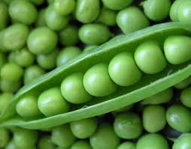
One Experiment…
Altered protein in GM peas from a kidney bean transgene may have turned them deadly
Transferred gene was for a naturally occurring pesticide in kidney beans. Amino acid sequence verified to be the same but …… serious allergic reaction in rats.
Agricultural
Food Chemistry,
2005
Notes:
In Australia, they took a gene from a kidney bean, which produced a certain pesticide, and inserted it into peas to kill the pea weevil.
These GM pea developers decided to do an allergic-type test on mice that no other GM food crop developer had done before. When they exposed mice to the proteins from the kidney beans, it caused no reaction. They expected the same to happen when mice were exposed to the “same” protein produced by the transgene inside the peas. In fact, the amino acid sequence was identical in both proteins—the one produced by both the bean and the pea. But the mice developed an inflammatory response to the protein produced in the GM peas. It was an immune type response that was very dangerous, suggesting that the peas might create a deadly anaphylactic shock or other types of immune or inflammatory reactions in humans. They never marketed the GM peas.
But why did the mice react if the protein was the same as the natural protein found in kidney beans? They conducted an advanced test and looked very carefully at the protein structure and found that the sugars that had attached had a slightly changed pattern. They said it was the slightly changed pattern of the sugars that made the peas harmful.
The problem is that the potentially deadly GM peas had already passed all the allergy tests that are normally used to get GM foods on the market. The only reason they were stopped was because the Australian crop developer had chosen to use a mice study that had never been used on any other GM food crop. This shows that the regulatory system, as practiced, is a failure, and may be letting deadly allergens on the market. Ironically, when Monsanto’s representative was asked about the cancellation of the peas (developed by another organization), he said that it proved that the regulatory system works. He never mentioned that none of his own company’s products had ever used the same advanced mouse test, and that they may be creating allergic reactions.
[V. E. Prescott, et al, “Transgenic Expression of Bean r-Amylase Inhibitor in Peas Results in Altered Structure and Immunogenicity,” Journal of Agricultural Food Chemistry (2005): 53.]

Slide 67
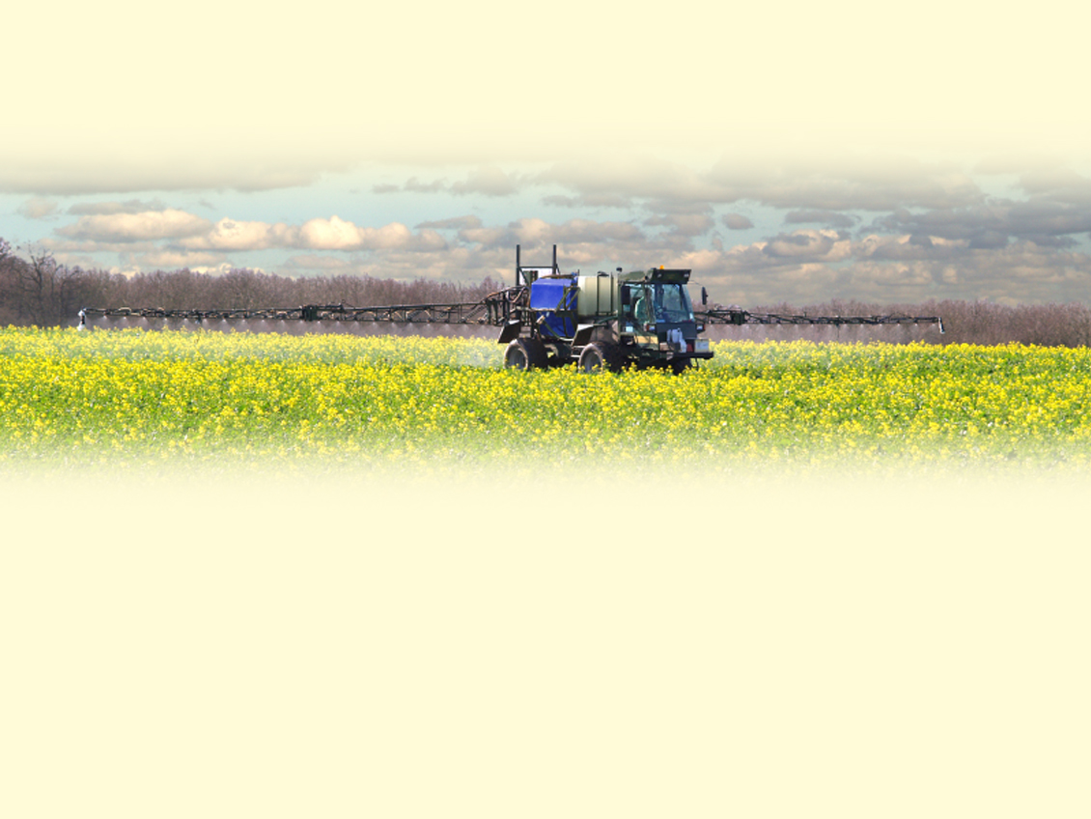
Fourth possible problem
More… & MORE
herbicide
residues
Notes:
The fourth possible problem is that more herbicide residues will be present on herbicide tolerant crops. The two primary herbicides used on these crops are Roundup and Liberty, with the active ingredients glyphosate and glophosinate. There is plenty of evidence showing that these are toxic to human beings and animals. Roundup, for example, has endocrine disrupting effects that may inhibit fertility or lead to birth defects. This does not say anything about the adjuvants, the other chemicals added to increase the effectiveness of the primary chemical.

Slide 68
GM crops increased herbicide use by 527 million pounds over the first 16 years (1996-2011)
Glyphosate use per acre on:
RR soy up 227% (16 yrs)
RR corn up 54% (15 yrs)
RR cotton up 206% (15 yrs)
Herbicide use on Non-RR soy dropped by 20% over the same time period.
Over 14 million US acres are infested with glyphosate-resistant weeds. Now over 880 million pounds of Roundup are being used annually worldwide… headed for 1 billion.
Notes:
The emergence of herbicide tolerant weeds is a primary reason why the use of herbicides, particularly Roundup—with it’s active ingredient glyphosate—has increased dramatically in the US. GM crops have resulted in more than a half a billion pounds more toxic herbicide used over 16 years. And go to your local hardware store….. Roundup everywhere.

Slide 69

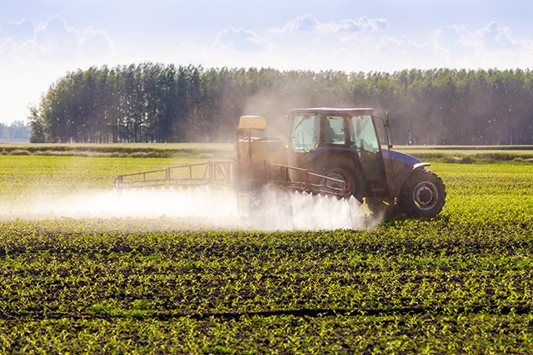
GM crops increased herbicide use by 527 million pounds over the first 16 years (1996-2011)
Glyphosate use per acre on:
RR soy up 227% (16 yrs)
RR corn up 54% (15 yrs)
RR cotton up 206% (15 yrs)
Over 14 million US acres are infested with glyphosate-resistant weeds. Now over 880 million pounds of Roundup are being used annually worldwide (284M in USA in 2012)… headed for 1 billion
Herbicide use on Non-RR soy dropped by 20% over the same time period.

Slide 70
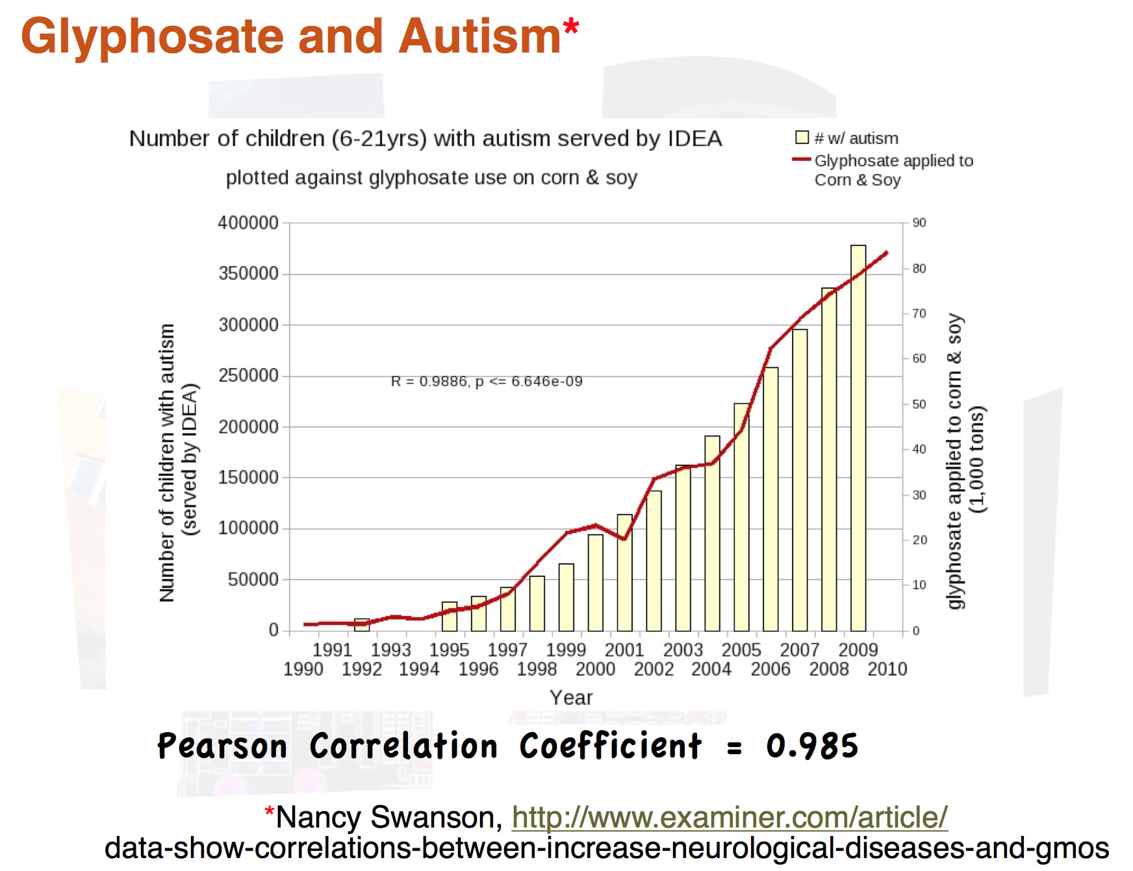
IDEA – Individuals with Disabilities Education Act ; data kept by the Department of Education
Notes:
Just ran into this data. Dr. Swanson

Slide 71
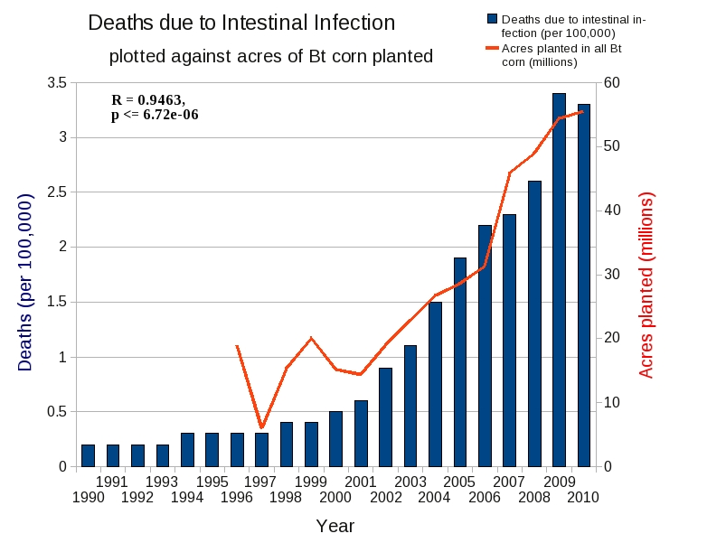
Notes:
Just ran into this data. Dr. Swanson

Slide 72
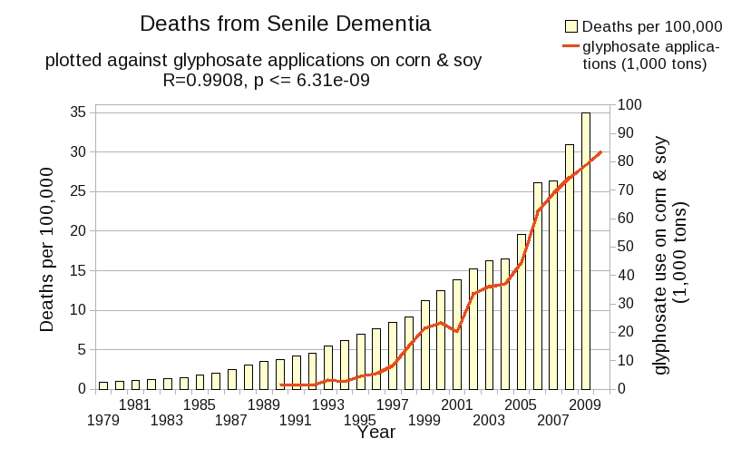
Notes:
Just ran into this data. Dr. Swanson

Slide 73
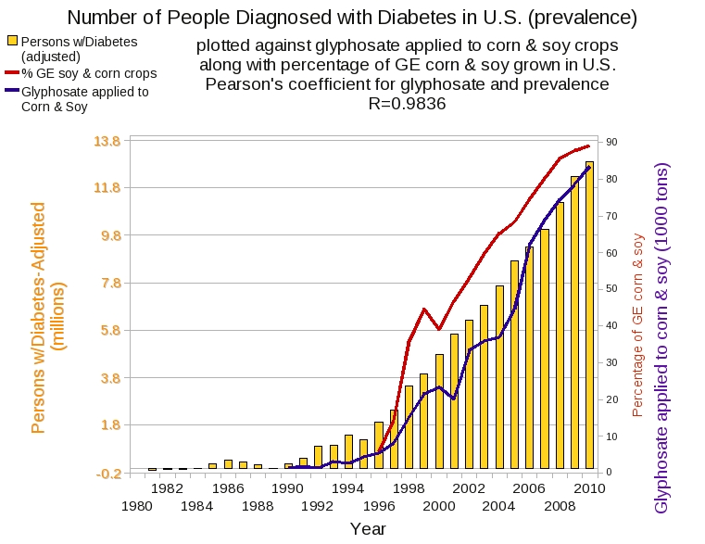
Notes:
Just ran into this data. Dr. Swanson and Dr. Seniff

Slide 74
High Correlation with Glyphosate Application
Alzheimer’s
Diabetes
Kidney disease
Thyroid cancer
Pancreatic cancer
Urinary/Bladder cancer
Liver cancer
Leukemia
Hypertension
Stroke
Senile dementia
Multiple Sclerosis
Intestinal Infection
Irritable Bowel disease
Attention Deficit Disorder
Parkinson’s disease
Autism
Metabolism disorder
Obesity
March 2015 – Glyphosate determined to be a “probable human carcinogen” by the World Health Organization – International Agency for Research on Cancer

Slide 75
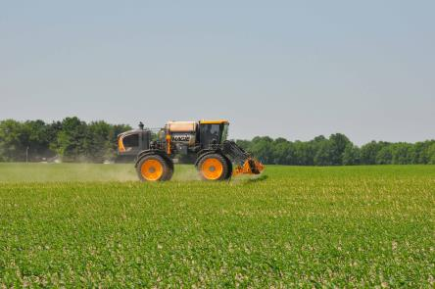
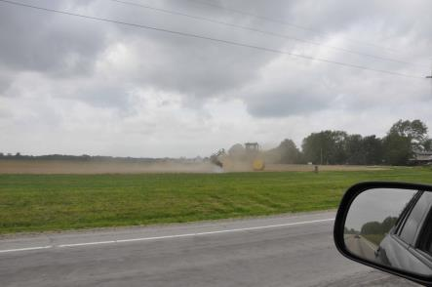
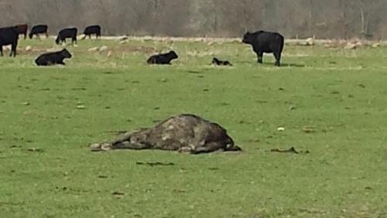
Our World
Howard County on Corn
June 2014
Cass County on Soy Beans
June 2014
Miami County
May 2014
Notes:
Laying down of RoundUp on corn and soy beans

Slide 76

Fifth possible problem
Gene transfer to
gut bacteria or
into our DNA
Notes:
The fifth possible problem is that the transgene that was inserted into the crop might transfer into our gut bacteria or into our own cell’s DNA.

Slide 77
Bacterial sequences are easier to transfer to bacteria
The gene’s promoter works in bacteria
Transfer of transgenes to gut bacteria is optimized
Notes:
Normally, natural barriers prevent plant cells from transferring into bacterial cells, or prevent them from functioning in bacteria if they do transfer. The first requirement is similarity of sequence. To transfer into bacterial DNA, a gene should have a sequence that is very similar to bacterial DNA. But plant sequences are quite different. They are also longer. GM crops, however, have transgenes from bacteria inserted into their DNA. They are similar in sequence and length and may readily transfer to gut bacteria.
If natural plant genes were to transfer to bacteria, they probably wouldn’t function for two reasons. First, embedded within plant genes are non-coding portions called introns. Although plants remove the introns before creating the RNA and proteins, bacteria would not likely know how to read the genes with introns. Second, plant promoters (or on-switches) do not generally work in bacteria. So the transferred gene would not likely be switched on inside bacteria. But GM transgenes have no embedded introns and they use a promoter that does work in bacteria.
Thus, while plant based foods do not likely end up contributing genes into our gut bacteria, GM crops might do so regularly, colonizing our very important gut flora. And if the transgene continued to function after transfer, it may produce GM proteins continuously inside of us. If these proteins confer a survival advantage to the bacteria, it would likely proliferate over the long term. So, we might have functioning transgenes living in the DNA of gut bacteria long after we stop eating GM foods
Transgenes might also transfer into our own cells. In a German study, fragments of non-GM DNA fed to pregnant mice were found in the brain of the offspring. Other studies also found that some DNA from food does travel through the body and can end up in various organs.

Slide 78
The Only Human Feeding Study on GM Crops
Roundup Ready soy: Genes transferred to intestinal bacteria
Notes:
The only human feeding study ever conducted on GM foods verified that a portion of the Roundup Ready soy transgene transferred into bacteria living inside our intestines, and continued to function.

Slide 79
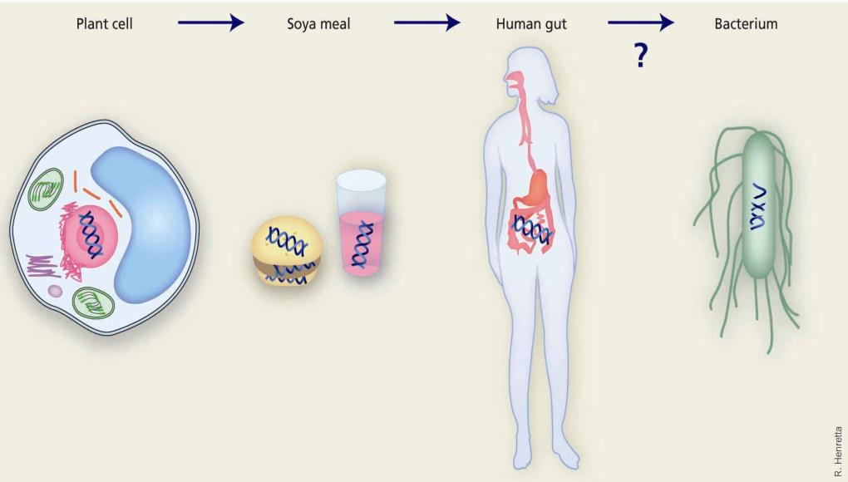
Nature Biotechnology, 2004
Notes:
The study used 7 human volunteers with colostomy bags. They had their lower intestines removed. One of the things they were testing for was the biotech industry’s claim that genes were destroyed during digestion. After feeding the volunteers GM soy burgers and GM soy milkshakes, they found a significant amount of GM soy transgenes in the colostomy bags. The GM soy had survived passage through the stomach and lower intestine, overturning the myth that digestion of genes made gene transfer impossible.
More importantly, in the gut bacteria of 3 of the 7 volunteers, the transgene from soy was integrated into the DNA of their gut bacteria BEFORE they had the meal. This means that it was integrated from a previous meal. Thus, genes do transfer to gut bacteria and they continue to function. We don’t know under what conditions transgenes transfer to gut bacteria and we don’t know its medical implications or treatment.
[Netherwood et al, “Assessing the survival of transgenic plant DNA in the human gastrointestinal tract,” Nature Biotechnology 22 (2004): 2.]

Slide 80
Promoter (On)
Antibiotic resistant marker gene
Roundup Ready
gene
Liberty Link gene
Viral gene
What
can transfer?
Notes:
What can transfer?
The promoter or “ON switch” might transfer. It can permanently turn on some random gene, forcing it to overproduce a protein around the clock. That protein may be an allergen, toxin, anti-nutrient, or carcinogen produced inside our gut bacteria or possibly from within our own cell’s DNA. In the soy burger study mentioned earlier, the promoter transferred with the soy transgene, into human gut bacteria.
If antibiotic resistant genes transfer, they might create super diseases, resistant to antibiotics.
We know the roundup ready gene transfers from soybeans.
There are virus resistant genes that could transfer from zucchini, papaya, and crookneck squash.

Slide 81
If Bt genes transfer
They might turn our intestinal bacteria into living pesticide factories
Notes:
What if the Bt gene transfers? It could theoretically turn our intestinal flora into living pesticide factories, possibly for the long term. It is a good excuse to avoid eating GM corn chips, made from pesticide producing Bt corn.

Slide 82
Summary:
Possible Sources of Problems
Unexpected changes in recipient DNA
GM protein may be harmful
GM protein may be different than intended
More herbicide residues
Transfer of genes to gut bacteria and/or our DNA possible
Notes:
To summarize the five possible problems we have presented, The DNA is disrupted, the protein you’re intending to create might be a problem, the protein might be altered or function differently, there are higher herbicide residues, and GM genes might transfer.

Slide 83

If GM crops are so bad, why don’t we
Hear about more problems?
Notes:
If GM crops are so bad, why don’t we see more problems?

Slide 84

L-tryptophan produced by GM bacteria
Killed about 100 and caused
5,000-10,000 to fall sick in the 1980s
Notes:
One reason is illustrated by the story of L-tryptophan, a food supplement sold in the US in the 1980s. There were 6 companies that were exporting L-tryptophan from Japan to the US. One company Showa Denko, was the only one that was genetically engineering the bacteria for the production of the product. That almost certainly created the contaminants within L-tryptophan which was responsible for this deadly epidemic. It killed about 100 Americans and caused another 5-10,000 to fall sick or become permanently disabled.

Slide 85

The epidemic was discovered
because the disease
Was new, with unique symptoms
Acute
Came on quickly
Notes:
It took years to discover that the epidemic was underway. It required a series of coincidences, plus the fact that the disease had three concurrent characteristics. The disease:
Was new with unique symptoms that stood out,
It was acute so people went to doctors or hospitals,
It came on quickly, so they went to doctors right after taking it,
Imagine if one of these three characteristics was not present. What if it created common diseases such as cancer, heart disease, diabetes, or obesity. It would likely have remained undiscovered and would still be on the market. Similarly, if it created symptoms that weren’t so serious or if symptoms didn’t come on quickly, it might never have been traced to L-tryptophan.
We don’t know if GM foods, which were widely introduced in late 1996, contributed to the fact that food-related illnesses in the US doubled between 1994 and 2001. Or the fact that the percentage of Americans that suffer from 3 or more chronic illnesses jumped from 7% in 1996, to 13% in 2004. And we can’t be sure if GMOs contributed to the increase in allergies, asthma, migraines, ADD, or diabetes.

Slide 86

No post-marketing surveillance
Current Assessments
No human clinical trials
No proper evaluation
of plant changes
or effects
Approvals based on
disproved or untested
assumptions
Industry studies only
Approval by Decree
Notes:
We don’t know because there is no post-marketing surveillance
No human clinical trials are being carried on
No proper evaluation of plant changes or effects
And government approvals are based on disproved or untested assumptions, or industry studies, which are widely criticized as biased to avoid finding problems.

Slide 87

How do we stop the genetic engineering of our food supply until rigorous long-term studies prove safety….or not?
Notes:
Although genetically modified organisms (GMOs) are one of the most dangerous health and environmental risks we face, they are also one of the easiest of our major problems to solve. Unlike transfats or sugar, GMOs don’t offer any perceived consumer benefits. Furthermore, when consumers realize the health risks, they are highly motivated to choose brands without GMOs. Just a small percentage of the population switching to non-GMO brands will create a tipping point, forcing major food companies to quickly replace GM ingredients.

Slide 88

Dr. Arpad Pusztai
Did It!
Notes:
The gag order preventing Dr. Arpad Pusztai was lifted on February 16, 1999, and the press when wild. More than 750 articles were written within a month, which propelled the issue of GMO food safety into the mainstream awareness. People were concerned about the health effects, and using GM ingredients became a liability. The European tipping point was achieved within 10 weeks of the lifting of Dr. Pusztai’s gag order.

Slide 89





Landslide among manufacturers
Removed GMOs from EU!
Notes:
At the end of April 1999, within a single week, virtually all major food companies committed to remove GMOs.

Slide 90
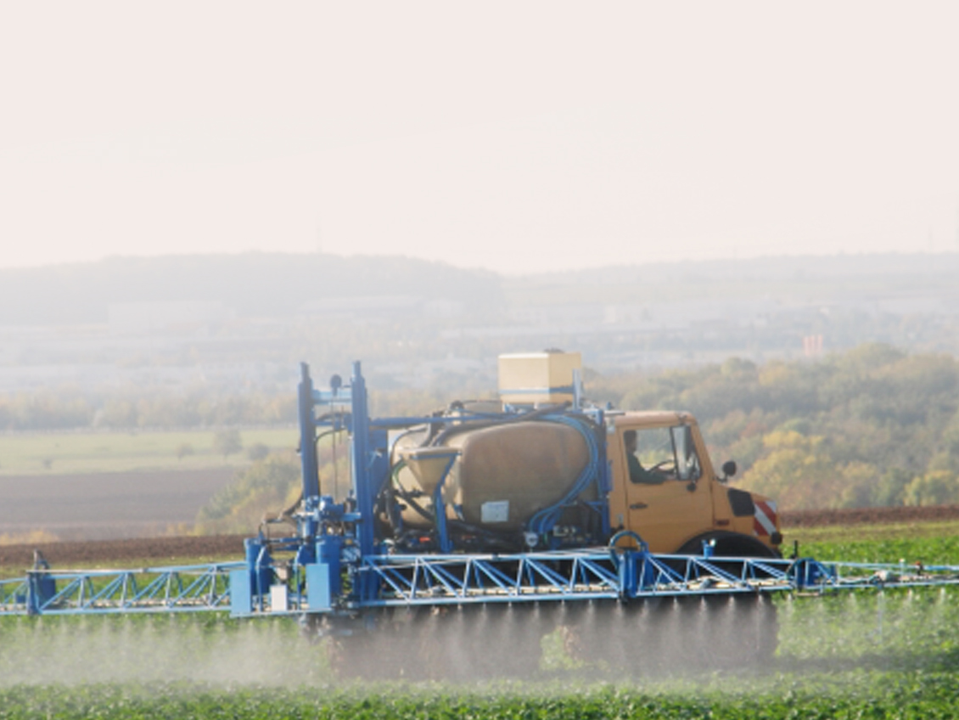
Expansion has been Limited…
So Far!
4 major crops
2 major traits
6 countries primarily and mostly in the Western Hemisphere
2.4% of global agricultural land
Notes:
The rejection in Europe has contained the expansion of GMOs. Whereas the biotech industry was literally targeting a conversion of all commercial seeds in the world to become genetically engineered, it has been limited to 4 major crops with 2 major traits, produced in 6 countries on a total of 2.4% of the world’s agricultural land. However, the United States continues to push for wider spread use of GM crops.

Slide 91

US awareness is low mainly because our foods are not labeled!
As far as you know, have you
ever eaten genetically
modified foods?
No........................................60%
Don’t Know...........................15%
Yes.......................................25%
Notes:
Unlike in Europe, the mainstream press has not covered the GM issue in the US. If you ask the average American “have you ever eaten genetically modified foods?,” 60% say no, 15% say I don’t know. The success of the GM food industry in the US is based on consumer ignorance.

Slide 92

Countries that Label GM Foods
All European Union countries
Russia
China
Australia
Japan
South Africa
64 countries world wide require labeling
Several Ban GM Foods Altogether

Slide 93

USA Does Not Label!!
Monsanto says …… Trust Us!
DDT
PCBs
Dioxin
Agent Orange
rBGH
GMOs
Notes:
Right now, we do not label foods containing GMOs in full or in part….. Primary ingredients or derivatives from those. In California, Proposition 37 for labeling was defeated after a media advertising blitz by the GMO companies and food processors to the tune of about 45 million dollars. Much of the advertising was to lower income areas where food price sensitivity is the greatest. Other states have introduced labeling legislation only to back out following threats of law suits again the state by Monsanto and others. Threat, intimidation, and what some say is false advertising have kept labels out of the United States.

Slide 94

Who is Trying?
Vermont (Passed!)
Maine (Passed)
Connecticut (Passed!)
2 Oregon counties – banned GM crops
California (Defeated)
Oregon & Colorado (Defeated)
Washington State (Defeated)
26 States had Bills introduced in 2013-2014
Indiana had 2 bills in 2015…. buried
BUT …. Danger! with Congressional bill HR1599 to block state legislation; Passed House… on to the Senate!
Notes:
Several states have tried to institute labeling of GMO foods. All have failed so far with the exception of Connecticut which just passed labeling legislation having “triggers”. California Prop 37 was just defeated after $45 million or so in advertising by corporations against labeling. Washington State is coming up. The HB0903 was introduced by a Representative from Colorado, Jared Polis (D). My guess: it will likely go nowhere.

Slide 95

American Medical Association
Do not support special product labeling without evidence of material differences…
BUT..Believe that pre-market safety assessment should shift from a voluntary notification process to a mandatory requirement.
Notes:
What about the medical community? Many healthcare professionals are becoming aware of the dangers of GMOs and are prescribing non-GMO diets to their patients. Allergist Dr. John Boyles says, “I used to test for soy allergies all the time, but now that soy is genetically engineered, it is so dangerous that I tell people never to eat it—unless it says organic.”

Slide 96
The American Academy of Environmental Medicine
“Animal studies indicate serious health risks … including infertility, immune dysregulation, accelerated aging, dysregulation of genes associated with cholesterol synthesis, insulin regulation, cell signaling, and protein formation, and changes in the liver, kidney, spleen and gastrointestinal system.”
Notes:
In May 2009, the American Academy of Environmental Medicine released a policy paper urging all doctors to prescribe non-GMO diets for everyone, stating that animal studies show that GM food is linked to infertility, immune problems, accelerated aging, organ damage, and gastrointestinal problems. They called for a moratorium on GMOs, and mandatory labeling. Here is a quote from their document: “Animal studies indicate serious health risks … including infertility, immune dysregulation, accelerated aging, dysregulation of genes associated with cholesterol synthesis, insulin regulation, cell signaling, and protein formation, and changes in the liver, kidney, spleen and gastrointestinal system.”

Slide 97

Religious groups
Notes:
Many religious groups have taken a strong stand against GM foods. Now they can also distribute information on the health dangers, and give their members the Non-GMO Shopping Guide.

Slide 98
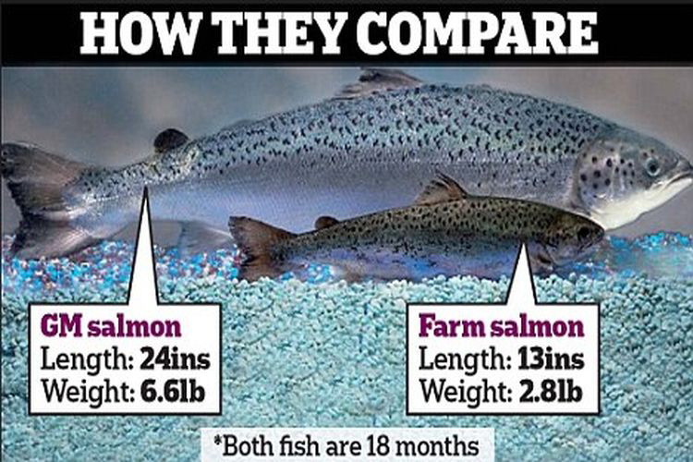
GM Salmon?
Notes:
GM Salmon are in the final stages of the approval process by the FDA. Over one million comments have been received by them. Most are against GM Salmon. What has been proposed by AquaBounty is the spawning of fish in confinement facilities in Canada, shipment of eggs to a secure facility in Panama where the fish would be grown out, then shipment back to the US markets. One concern is about the escape of GM Salmon into a wild population where they might have a reproductive advantage (Muir). One study suggests that within 40 generations, the wild type would become extinct. The Purdue professor who published this study now believes what is proposed is safe due to the precautions taken. Quadruple containment along with thermal barriers would prevent wild contamination. However, there is indication that several US based locations are interested in growing out this fish. All bets off if this happens.

Slide 99
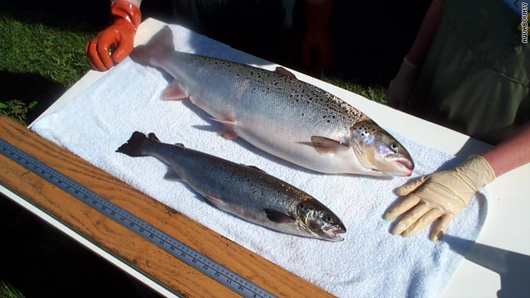
Same age; Hormone ON

Slide 100
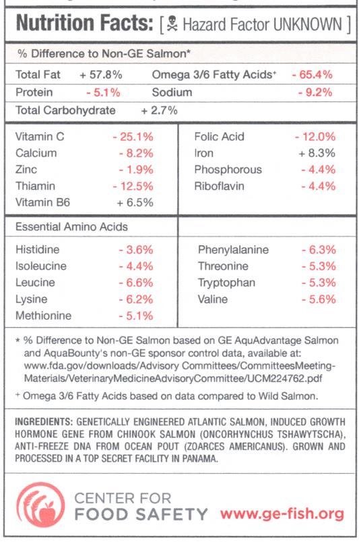

Slide 101
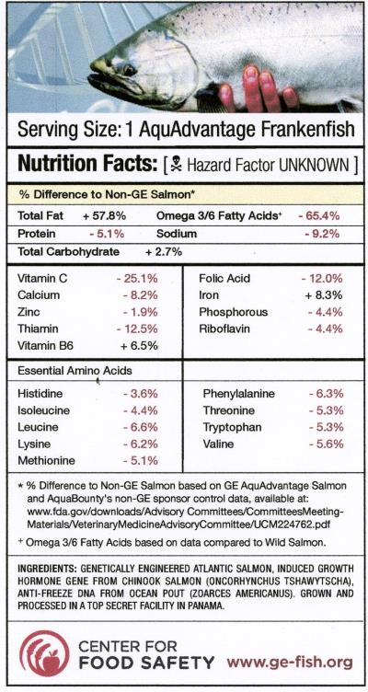
Notes:
AquaBounty claims no significant difference between the flesh of the GM fish and a wild type or pen fed fish. Here are the results of a nutrition analysis. You be the judge. And this does not consider what has not been identified. That is not even looked for. Such as potentially new toxins, new allergens, new antigens….. Etc.

Slide 102
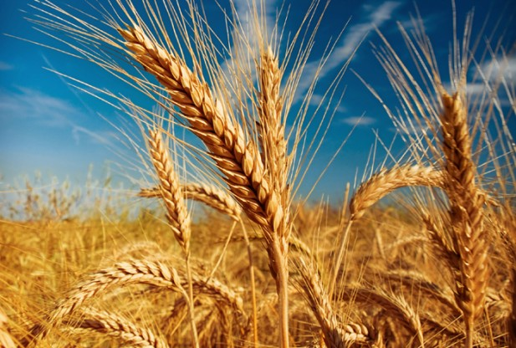
GM Wheat found in Oregon
& most recently in Montana!
Notes:
Very recently, GM Wheat was found growing in a field in Oregon. No GM wheat has ever been approved. Monsanto field trials were conducted in over a dozen states but terminated several years ago. The wheat industry has rejected GM wheat because of concerns about the marketability worldwide of genetically engineered wheat. Japan and South Korea and others have put wheat shipments on hold until the extent of the contamination of the wheat crop has been determined. Monsanto and other chemical/seed companies continue to push for more and more genetically engineered crops of all kinds for the world market.

Slide 103
Post Script
“Junk DNA” not “Junk”
Local story about “refuge corn” crop and cattle grazing
Indiana farmer and Supreme Court case regarding Monsanto patent life on soy beans; farmer lost
Recent story about new E Coli strain highly resistant to even antibiotics of last resort; 50% fatal
Notes:
Only in the past year or so have scientists decided that what was called “Junk DNA” is not. It contains all sorts of switches, regulators, and controls on DNA expression. They admit it will take years or even decades to decipher what is there.
There is a local Indiana farmer that I just heard about. He grows corn, GM corn, but as suggested has a section of “refuge” corn which is not genetically modified in his field. This supposedly is attractive to pests normally found in corn. After harvest, he normally turns livestock into the fields to eat what was missed in harvesting. He has noticed time and again that the cattle will seek out the “refuge” corn before touching the GM corn.
There was a 75 year old SW Indiana farmer with a case before the Supreme Court. The farmer typically buys surplus soy beans from a local elevator for use as feed. He decided to try to get a second crop with some of the beans. Monsanto says he owes royalties. The question is the patent life limited or does it run in perpetuity in GM organisms that replicate the modified DNA. The decision was for Monsanto. The farmer was not “lily white”. He knew a portion of what he purchased and used as seed corn was GM seed. He used Roundup on the crop to kill weeds. The big question, though, was did the patent end or not with the first planting. It does not.
New Ecoli strain highly resistant to antibiotics in the news recently. Already there are concerns in the medical community about antibiotic resistance. Well over half of the antibiotics used in the United States are in animal feed or otherwise administered to animals in the human food supply.

Slide 104

How do we avoid GMOs?
Buy ORGANIC
Buy products that are labeled “Non-GMO”
Buy products listed on a
Non-GMO Shopping Guide
Avoid at-risk ingredients
www.NonGMOShoppingGuide.com
for shopping guides and tips
Notes:
In order to avoid eating GMOs, you must:
Buy organic, which is not allowed to use GM inputs
Buy products that are labeled Non-GMO
Buy products listed on a Non-GMO Shopping Guide
Or read labels and avoid the at risk ingredients, such as soy protein isolate, lecithin, high fructose corn syrup, dextrose, maltodextrin, and all corn derivatives, canola and cottonseed oil, etc.
At www.NonGMOShoppingGuide.com you will find more information on how to avoid GM foods.

Slide 105

Recommended Books

Slide 106



The End
Sturgeon
Daphnia
Medaka
Dr. Kent Blacklidge
www.visionengineers.com/informationresources

Slide 107
Genetic Engineering: The World's Greatest Scam?

Slide 108

US GM crops
Soy 94%
Corn 88%
Cotton 93%
Canola 90% (Canada)
Sugar beets 95%
Alfalfa (hay, not sprouts) ?%
Notes:
108
What is genetically engineered in the US?
Right now soy, corn, cotton, canola, and sugar from sugar beets are the main sources. Soy and Corn derivatives are in most processed foods. If it comes in a box from the supermarket, it is probably genetically engineered. The first four are used in vegetable oil. The US sugar beet growers introduced GM sugar at the end of 2009. Unless an ingredient says pure cane sugar, it is a mixture of cane and sugar beet. GM alfalfa is used as hay for animals.

Slide 109

4. Increased herbicide
527 million pounds more in the first 16 years (US)
Increased fusarium on crops (wheat, soy roots)
Decreased trace minerals
Notes:
The fourth category is increased herbicide. In the first 16 years of GM crops, herbicide tolerant crops were responsible for an estimated increase in herbicide us of 527 million pounds.
The application of Roundup increases fusarium both on soy roots as well as in wheat. This creates micro toxins which may be dangerous for humans. Roundup also binds with minerals, making them unavailable for the plants, as well as for the animals and humans who eat the plants.

Slide 110


Independent
3rd party
Non-GMO Verification
Notes:
110

